Slide 1
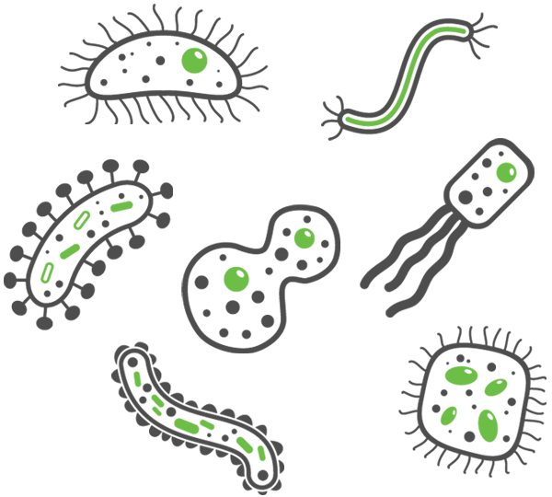
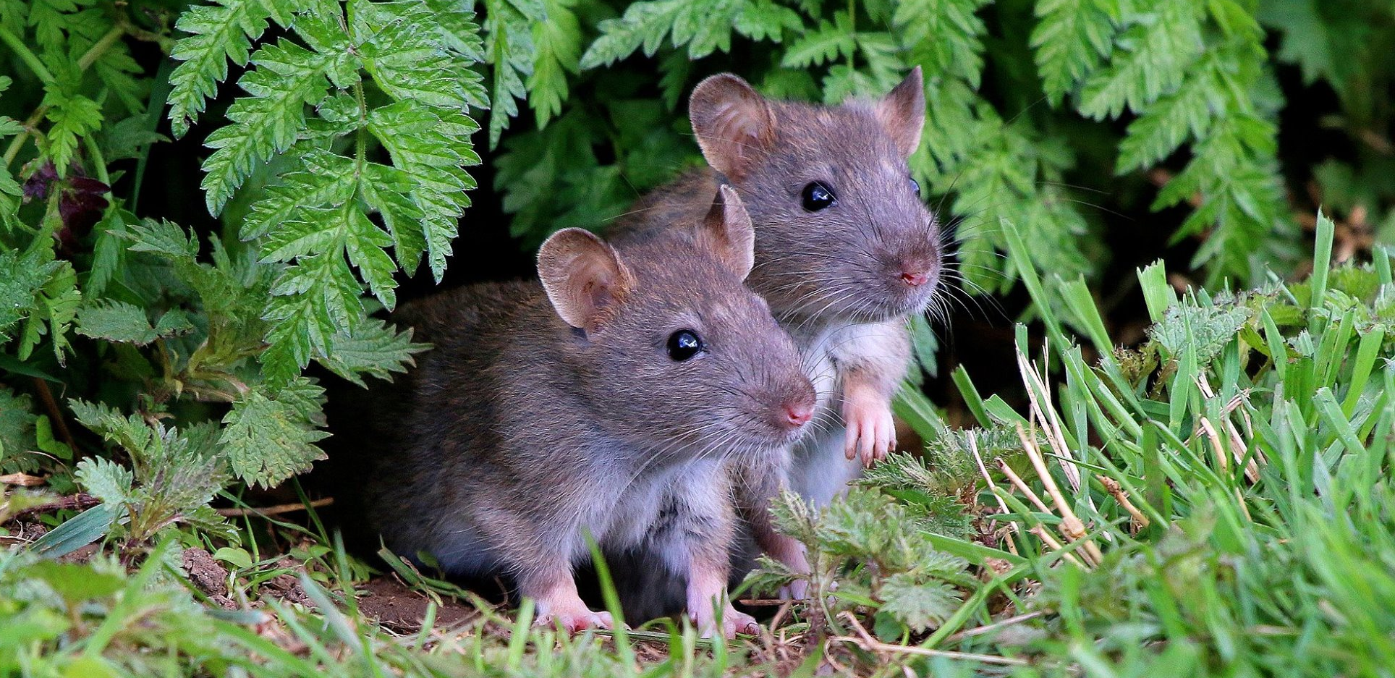
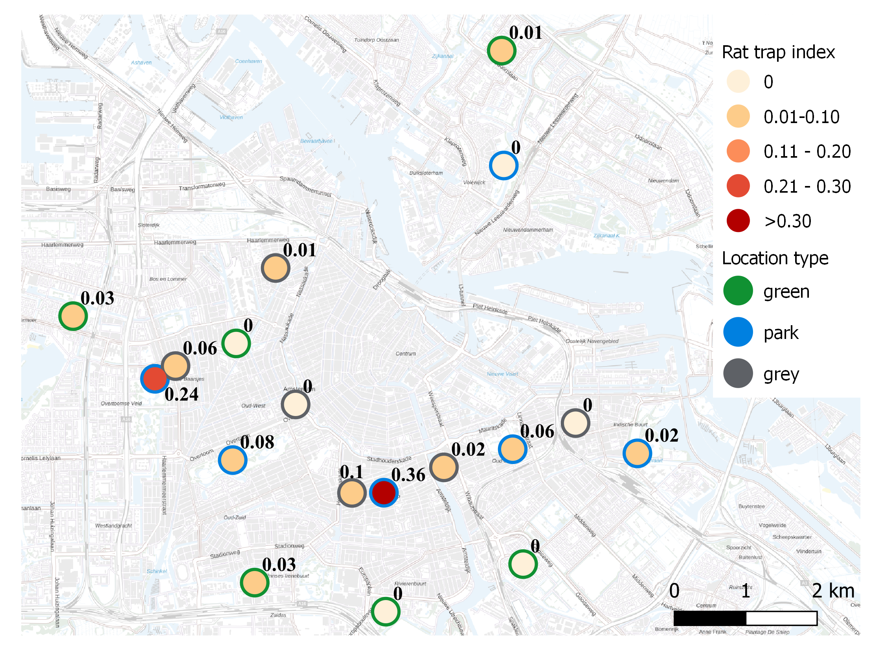
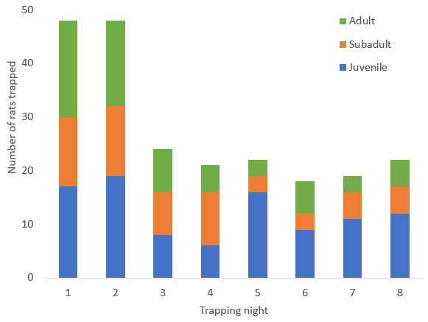
THE RELATION BETWEEN URBAN GREENSPACE, WILD RAT ABUNDANCE AND ZOONOTIC PATHOGEN PREVALENCE AND DIVERSITY
Authors: Marieke de Cock ¹, Manoj Fonville ¹, Ankje de Vries ¹, Hein Sprong ¹, Wim van der Poel ² and Miriam Maas ¹
Affiliations: 1: National Institute for Public Health and the Environment, Bilthoven, NL 2: Wageningen Bioveterinary Research, Lelystad, NL
Contact: marieke.de.cock@rivm.nl
Introduction
Results
Introduction
Increasing biodiversity is one of the many beneficial effects of urban greening. However, increasing biodiversity could also result in an increase of unwanted or pest species such as wild rats, which are known to be host to a wide range of zoonotic pathogens that can cause severe disease in humans. Therefore, it is important to gain more insight into the effect of urban green on pest species to minimize the potential negative effects for public health.
Rat pathogen prevalence and richness (Table 1):
• 13/17 zoonotic pathogens were detected in wild Rattus norvegicus in the Netherlands
• Highest pathogen prevalence was detected for Bartonella (25%) in parks
• No detection of Cowpox virus, Coxiella burnetii, Seoul orthohantavirus and Spiroplasma • Rat bodyweight had a sign. positive relation with the carriage of Leptospira, Bartonella, ESBL producing E.coli, ratHEV and Borrelia • Pathogen richness per rat ranged from 0-4 and was sign. positively related to both NDVI and rat bodyweight
Relative rat abundance (RRA): • No significant relation between RRA and NDVI
• Highest RRA in two parks in Amsterdam (Figure 1)
• Number of rats trapped is highest in the first two trapping nights (Figure 2)
Conclusions
Conclusions
• Older rats (with higher rat bodyweight) and rats living in greener urban areas carry significantly more zoonotic pathogens
• The relative abundance of rats in a certain location is not related to the amount of greenspace present (NDVI), though the two locations with the highest relative rat abundance are two parks in Amsterdam
• Most rats are trapped in the first two days after trap activation. The number of adults and subadults trapped decreases with time. The number of juveniles trapped seems to increase again after the weekend (between trapping night 4 and 5), which could indicate shorter lasting neophobic behaviour towards traps in young rats compared to older rats
Amsterdam
Rat trapping: Rattus norvegicus were trapped systematically in two different cities in the Netherlands (Amsterdam and Rotterdam) in 2020 and 2021 by using snap traps. Within these cities, rats were trapped in parks and residential areas with varying amounts of greenspace present (n=36 locations).The percentage of green in a certain location was measured using NDVI.
Relative rat abundance: Relative rat abundance was compared by calculating the rat trap index (total nr of rats trapped per location / nr of effective trapping nights)
Zoonotic pathogen detection: All captured rats were dissected and tested for 17 different zoonotic pathogens (as mentioned in the results table). These pathogens were tested using (q)PCR (in combination with ELISA or IFA).
Statistical model: Zoonotic pathogen carriage was modelled using a GLMM with binomial distribution and logit link function. Possible influencing factors (incl. NDVI, bodyweight, sex, season and location type) were included as variables in each pathogen model, trapping location was included as random factor. Pathogen richness per rat was calculated and modelled using a GLMM with poisson distribution. All analyses were performed in R and p<0.05 was considered significant.
Materials & Methods
Table 1
Pathogen prevalence (%) | Amsterdam (n=140) |  | Rotterdam (n=267) |  | Total (n=410)
 | Parks (n=97) | Residential areas (n=43) | Parks (n=48) | Residential areas (n=219) | Total prevalence
Bartonella | 47% | 19% | 34% | 17% | 25%
Leptospira | 23% | 14% | 27% | 18% | 20%
ESBL producing E.coli | 13% | 14% | 0% | 15% | 12%
Rat hepatitis E virus | 0% | 9% | 4% | 4% | 4%
Rickettsia | 9% | 12% | 0% | 1% | 4%
Borrelia | 9% | 0% | 0% | 2% | 3%
MRSA | 3% | 0% | 0% | 1% | 1%
Streptobacillus moniliformis | 2% | 5% | 0% | 1% | 2%
Salmonella | 0% | 0% | 0% | 1% | 1%
Toxoplasma gondii | 0% | 0% | 2% | 1% | 1%
Anaplasma | 1% | 0% | 0% | 0% | <1%
Babesia | 1% | 0% | 0% | 0% | <1%
NeoEhrlichia | 0% | 3% | 0% | 0% | <1%
Cowpox virus | 0% | 0% | 0% | 0% | 0%
Coxiella burnetii | 0% | 0% | 0% | 0% | 0%
Seoul orthohantavirus | 0% | 0% | 0% | 0% | 0%
Spiroplasma | 0% | 0% | 0% | 0% | 0%
Figure 1
Figure 2
Presented by: Marieke de Cock, MSc
Conference: International Conference for Urban Pests
Date: June 2022
Place: Barcelona, Spain

