Slide 1
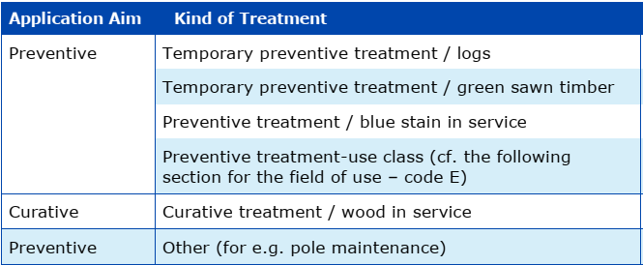
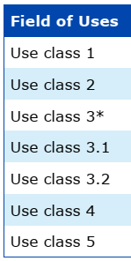
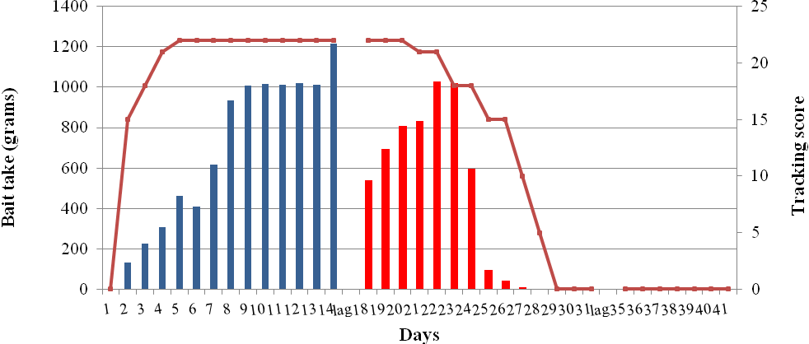
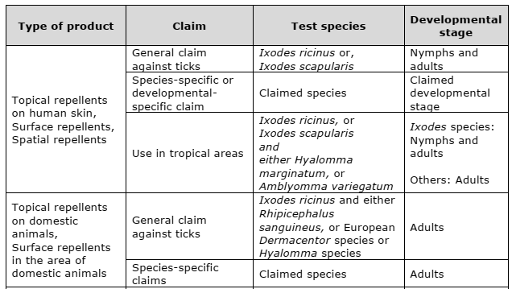
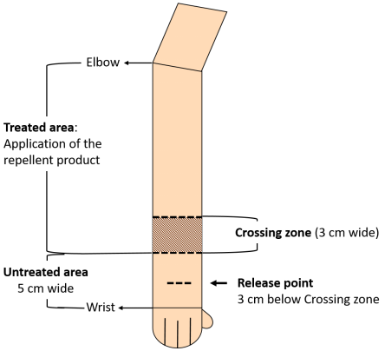
ASSESSMENT OF BIOCIDAL PRODUCT EFFICACY AGAINST URBAN PESTS : PRACTICAL EXAMPLES
Authors: Mathias BRIZARD, Nabila HADDACHE, Isabelle ATTIG, Catherine BILLAULT, Yann MAXIMILIEN, Alice MUFFAT-JOLY
Regulated Products Department - ANSES, Maisons-Alfort (France)
Keywords: Biocides, Urban pests, Efficacy criteria, Volume II part B/C ECHA guidance
How efficacy of biocidal products is assessed in the frame of the biocidal regulation (EU) 528/2012?
Here are presented examples for four product types (PT) corresponding to the typical urban pests (PT8, PT14, PT18 and PT19), following the efficacy guidance Volume II part B/C*. For each PT, claims and assessment are specific and different.
PT8 Products against wood pests
PT14 Products against rodents
1- Claims: A claim is a combination of the different categories presented below. Several combinations are possible for a same product.
1- Claims: Different target organisms (e.g. house mice, brown rat, vole.. etc.) and fields of use (e.g. indoor, outdoor, sewer,…) can be claimed.
2- Efficacy studies: the applicant should submit laboratory/semi field test and field test for each target in accordance with the claimed conditions of use.
Moreover, for bait product claimed to be effective after a long period of storage (>1 year without preservative and >2 years with preservative), it is necessary to demonstrate that the product will still be effective and palatable after the stated storage period for all target organisms claimed.
Example of wood preservative in UC2 against fungi:
2
2
3
4
5
2
2
3
4
5
Example of a field test for a bait product.
1
silos
haystacks
silos
haystacks
1
3
4
5
1
1
3
4
5
Baiting box during pre and post treatment
Baiting box during treatment
Tracking patch
Tracking patch
Brown rot fungi
3- Criteria: the same for all target organisms:
For laboratory and semi-field tests ≥ 90% mortality.
the percentage of ingested bait containing the product should be ≥ 20%.
For field test, a ≥ 90% decrease of the population.
2- Efficacy studies: Depending on the claim, the applicant should submit tests according to specific CEN standards as defined in EN 599 / 14128
Example of a bait-trays monitoring results
Efficacy criteria for preventive class 2 (EN 599-1)
Figure:
Daily bait take (histogram) and tracking score (line) during the trial period.
Blue bars, census bait takes.
Red bars, rodenticide bait takes.
4- Resistance assessment: Resistances for anticoagulants have been clearly established and reported since many years.
Harmonized instructions for use between Member States depending on the user are available and used for rodenticide anticoagulant products but no harmonization regarding the elements to be requested from the applicant concerning resistance is agreed.
In France, the applicant is requested to provide monitoring results of the resistance of rodent populations at the renewal of the authorization.
3- Criteria: The validation criteria for each standard must be fulfilled.
For EN 113-1: 3 mandatory strains (Coniophora puteana, Rhodonia placenta and Gloeophyllum trabeum), mass loss of a mass fraction <3.0%, the efficient concentration is based on the BRV of the most tolerant strain
4- Resistance assessment: No cases of resistances are reported or known up to the time being in the field of wood preservation.
PT18 Products against insects
PT19 Repellents against arthropods
Claims: combination of the target organisms, the type of treatment and the users (professional or non professional).
1) Claims: combination of the target organisms, the type of treatment and the surface to be protected (human skin, animals, clothes, porous surfaces…).
2) Efficacy studies: For a product against cockroaches: for non-professional users, laboratory and simulated-use tests could be sufficient.
However, for professional users and for bait product, an additional field trial is always required.
Required test species according to the type of product for repellents against ticks
3) Efficacy criteria:
For general surface treatment or aerosol for professionals:
Laboratory/SU tests:
Direct application: 100% mortality within 1 hour
Residual test: 100% mortality within 24h direct after spray and at the end of
the claimed residual period.
Field tests: ≥ 90% population reduction (after 2-10 weeks)
For bait product:
Laboratory tests (Palatability choice test) ≥ 95% mortality
SU tests ≥ 90% population reduction within a few weeks
Field tests ≥ 80% reduction of the population (relative to untreated sites or
pre-treatment levels).
2) Efficacy studies: For repellent product on human skin against ticks a simulated-use test should be provided.
Simulated-use test on human forearms against ticks:
10 volunteers,
10 ticks per hour,
3 min observation time
3) Efficacy criteria: Complete Protection Time (CPT): time between application of the product and demonstration of its ineffectiveness (not repelled during the observation time).
CPT should correspond to the shortest CPT (mean or median) among the tested species and developmental stages.
4) Resistance assessment: The resistance management depend on the type of users and the active substance of the claimed product.
Based on the literature review, different specific instructions of use can be added between professional and non professional users.
Ex: Adopt integrated pest management methods such as the combination of chemical, physical control methods and other public health measures, taking into account local specificities (climatic conditions, target species, conditions of use, etc.).
A tick is not repelled when it, within the 3 minutes observation time, either:
• Crawls onto the treated area and remains there for 1 min, or
• Enters the treated area and further crawls across the 3 cm crossing zone
within less than 1 min after entering the treated area.
Moreover, in the event that resistance is established or reported, monitoring data could be requested from the applicant at the renewal of the authorization.
4) Resistance assessment: The occurrence of resistance and resistance management depend on the active(s) substance(s). Based on literature review on target and active substance, specific instructions of use can be added.
* Guidance on the Biocidal Products Regulation Volume II Efficacy - Assessment and Evaluation (Parts B+C) Version 4.0 December 2021

